Slide 1
Safe Online Shopping
Learning objectives:
Learn to recognize the basic elements of online store
Learn how to choose and pay for goods
Learn what information you can safely give from you
Learn what to pay attention to in order to avoid fraud and shop safely online
Notes:
Go through the learning objectives with the course participants before you begin teaching. This will make it easier for them to learn and to remember what they have learned. Remember that online shops are different, and take the time to answer questions as you go along. It might be a good idea to ask the participants to bring their own debit card, credit card and online banking code generators to class so that they can make purchases when you have finished teaching.

Slide 2
Part 1
What is an online shop?
Notes:
Some online shops sell clothes or objects, but you can also order services, book travel and hotel rooms and a lot more. Some people shop online to save time and money. Others feel that they can find products and services online that they can’t find anywhere else. The first step when you want to buy something online is to find out which online retailer you want to use. Most people may know in advance which online shop they want to use. If you know what kind of product you want to buy but you’re not sure which online shop would have such a product, you can try to search for/google the product in your web browser to see if you can find any shops that appear to sell the product in question.

Slide 3
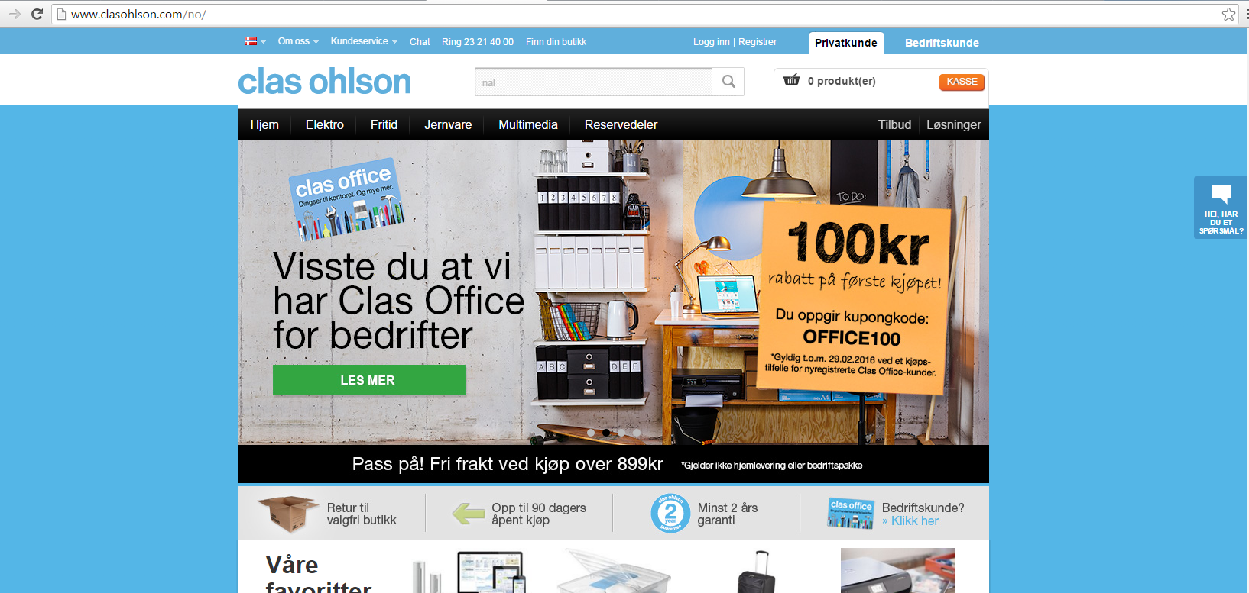
What is an online shop?
Notes:
Here are some examples of different online shops.

Slide 4
What is an online shop?
Notes:
Here are some examples of different online shops.

Slide 5
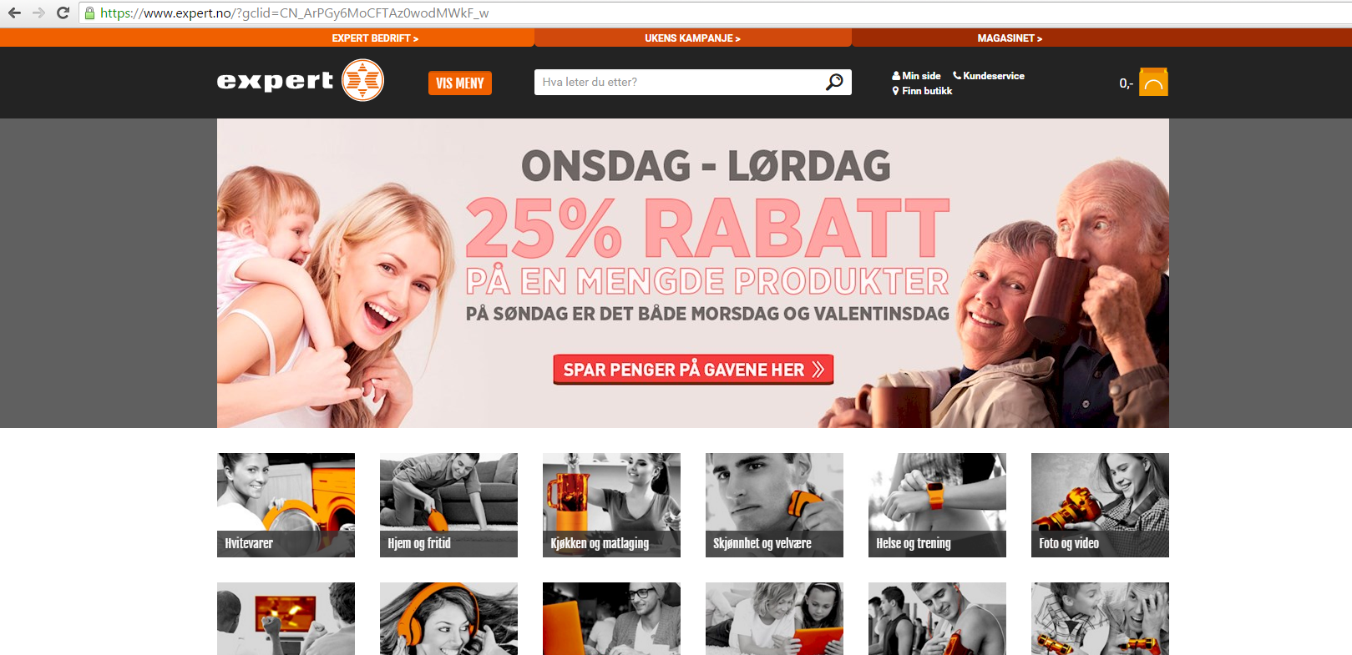
What is an online shop?
Notes:
Here are some examples of different online shops.

Slide 6
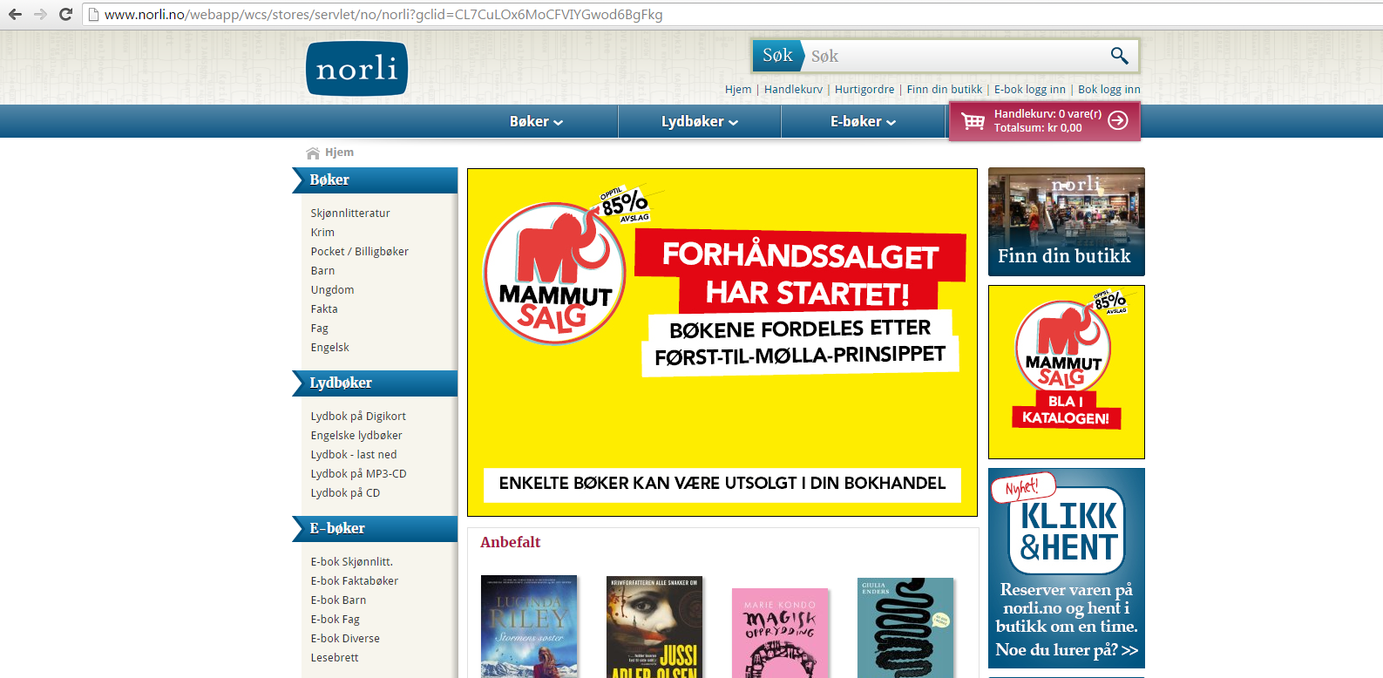
What is an online shop?
Notes:
Here are some examples of different online shops.

Slide 7
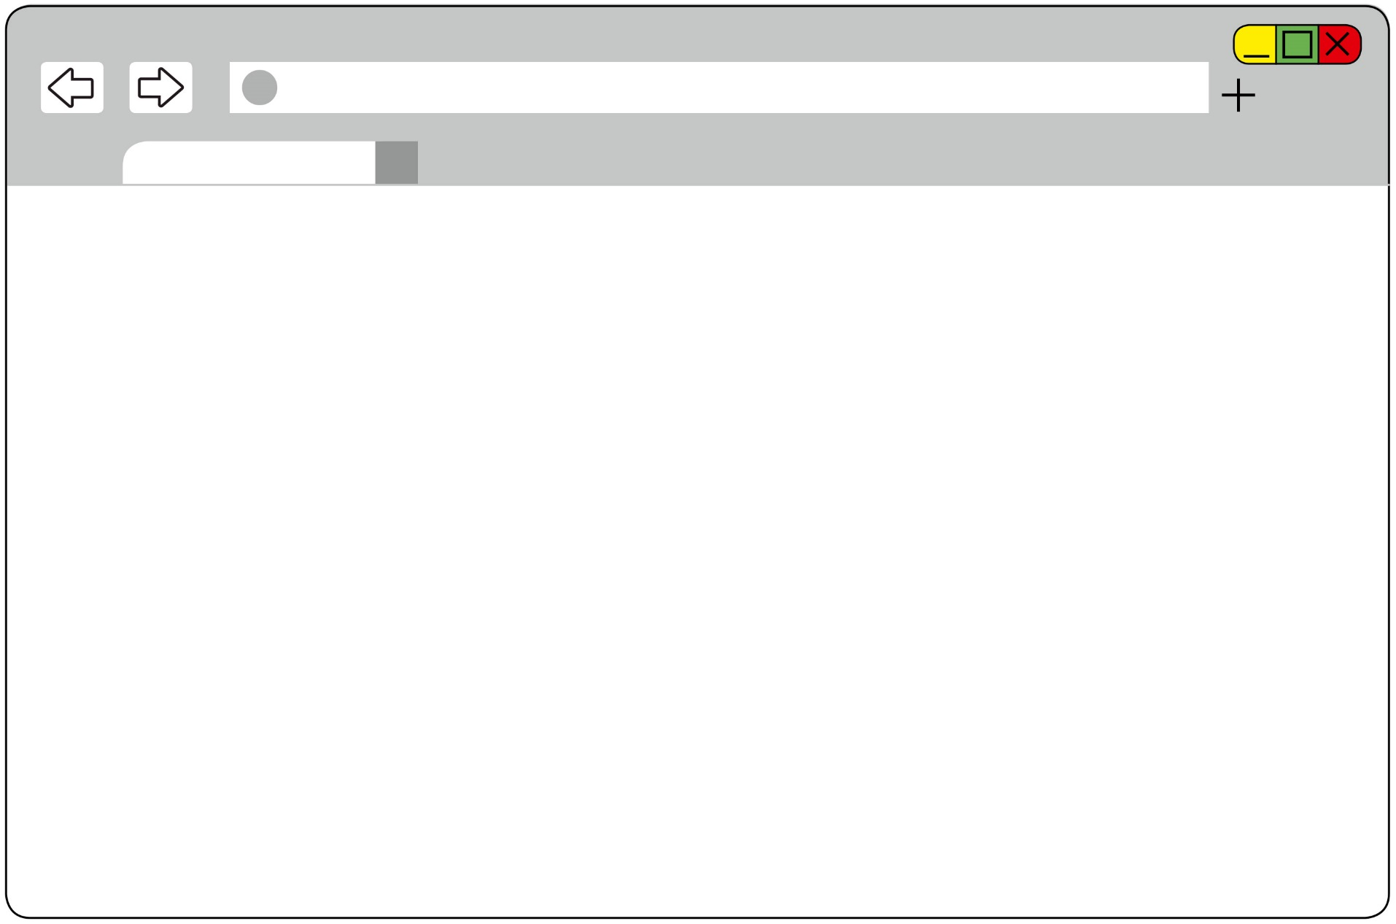
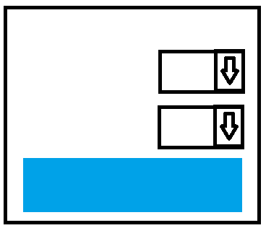
What is an online shop?
Nettbutikk
VARER
_________
_________
_________
_______
_________
_____
________
TOTAL xx,xx
Notes:
Most online shops have a pretty similar structure.

Slide 8
What is an online shop?
Nettbutikk
VARER
_________
_________
_________
_______
_________
_____
________
TOTAL xx,xx
Notes:
The first thing you’ll see is often a page where you can search for and read about the products.

Slide 9
What is an online shop?
Nettbutikk
VARER
_________
_________
_________
_______
_________
_____
________
TOTAL xx,xx
Notes:
On this page you’ll also see a ‘shopping trolley’ or ‘basket’ where the products and services you want to buy will end up.

Slide 10
What is an online shop?
Nettbutikk
VARER
_________
_________
_________
_______
_________
_____
________
TOTAL xx,xx
Notes:
To choose a product, click on it.

Slide 11
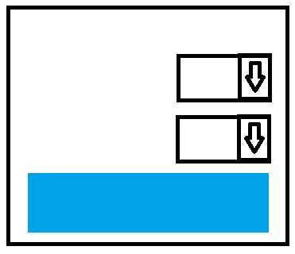
What is an online shop?
Ant.
Str.
PRIS: XX,XX
KJØP
Notes:
Just like in a normal shop, you can choose to buy one or more products.

Slide 12
What is an online shop?
1
PRIS: 99,50
Medium
KJØP
Notes:
Just like in a normal shop, you can choose to buy one or more products.

Slide 13
What is an online shop?
1
4
PRIS: 99,50
Medium
Small
PRIS: 295,-
KJØP
KJØP
Notes:
You can also buy several different products.

Slide 14
What is an online shop?
1
PRIS: 99,50
Medium
KJØP
Notes:
When you have put everything you want to buy into your basket, you need to find the checkout and pay.
If you click ‘Buy’, you will see that the product is placed in your basket.

Slide 15
What is an online shop?
Nettbutikk
VARER
_________
1 x_________
_________
_______
_________
_____
________
TOTAL xx,xx
KJØP
Notes:
If you click ‘Buy’, you will see that the product is placed in your basket.

Slide 16
What is an online shop?
1
Notes:
This basket only has one product in it.

Slide 17
What is an online shop?
5
Notes:
If you put more products in, the basket will be updated.

Slide 18
What is an online shop?
Nettbutikk
VARER
_________
_________
_________
_______
_________
_____
________
TOTAL xx,xx
4a
KASSE
Notes:
Also, the online shop has a checkout where you have to confirm your purchase and decide how you want to pay and how you want to have your product delivered. We’ll go back to this later.

Slide 19
What is an online shop?
Nettbutikk
VARER
_________
_________
_________
_______
_________
_____
________
TOTAL xx,xx
4a
BESTILL
Notes:
Online shops are not all the same.
Some use other terms than ‘basket’ and ‘checkout’. Some use ‘Order’ or ‘Add to basket’.

Slide 20
What is an online shop?
Nettbutikk
VARER
_________
_________
_________
_______
_________
_____
________
TOTAL xx,xx
4a
Legg i handlekurv
Notes:
Some online shops are also in other languages. But the process you go through is the same.
1. Find the goods you want to buy.
2. Proceed to checkout when you are ready to pay.
3. Pay for your goods.

Slide 21
Part 2
How to pay

Slide 22
How to pay
Nettbutikk
VARER
_________
_________
_________
_______
_________
_____
________
TOTAL xx,xx
Notes:
To pay, first you need to find the checkout. The easiest way to find it is to click on the basket. Besides showing you which products you have chosen, doing this will usually also give you an option to go to the checkout from there. Look for a button or link that says ‘Checkout’, ‘Go to payment’, ‘Proceed to checkout’ or something similar that will allow you to complete your purchase.

Slide 23
How to pay
Nettbutikk
VARER
_________
_________
_________
_______
_________
_____
________
TOTAL xx,xx
Til kasse
Notes:
To pay, first you need to find the checkout. The easiest way to find it is to click on the basket. Besides showing you which products you have chosen, doing this will usually also give you an option to go to the checkout from there. Look for a button or link that says ‘Checkout’, ‘Go to payment’, ‘Proceed to checkout’ or something similar that will allow you to complete your purchase.

Slide 24
How to pay
Notes:
At the checkout, you usually have to provide the following information to complete a purchase:

Slide 25
How to pay
Notes:
Name and address of recipient (you can choose to send the products to a friend or a family member)

Slide 26
How to pay
Adresse
Notes:
Name and address of the person paying, usually called the billing address (which will be you)

Slide 27
How to pay
Adresse
Notes:
Your email address and phone number (preferably a mobile number)

Slide 28
How to pay
Adresse
?
Notes:
Form of payment. You can often choose to be sent an invoice, to pay with a debit or credit card or another payment option.

Slide 29
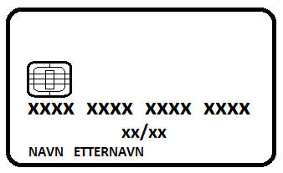
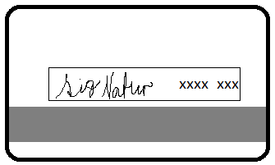
How to pay
Notes:
If you choose to pay with a debit or credit card, you will also be asked to give the name of the card owner, the card number and expiry date (found on the front of the card) and the CVC code (found on the back of the card, the CVC consists of the last three digits to the far right on the same line as your signature).

Slide 30
How to pay
Notes:
To complete the purchase, you must also agree to the terms and conditions of the online shop you are using.
The terms and conditions are often given as lists that can seem long and overwhelming. Still, it is important that you take the time to read quickly through them so that you know what you are agreeing to.
Pay particular attention to the parts that concern delivery, cancellation, returns and cancellations.

Slide 31
How to pay
Notes:
When you have familiarised yourself with this, you can tick the box to agree to the terms and conditions if you still want to buy the products.
Another important part of the purchase process is that you as the purchaser undertake to pay for the products. The online shop you are using should give you clear information about this as well as about your cancellation right.
The payment process may vary slightly from one online shop to another, so follow the instructions on the screen closely.

Slide 32
How to pay
Notes:
When your purchase is complete, you will usually come to a page where it says that your order has been received. Often, you will also get an email with the details of your order. Many online shops will even send you emails during the packaging and shipping process so that you know what’s happening to your products.

Slide 33
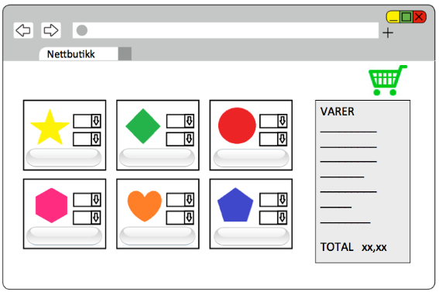
How to pay
Notes:
To summarise: you always need to go through the following steps to buy a product online:
1. Find an online shop

Slide 34
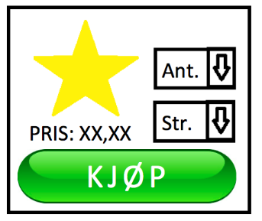
How to pay
Notes:
2. Choose products

Slide 35
How to pay
Notes:
3. Place products in your basket

Slide 36
How to pay
Notes:
4. Go to checkout

Slide 37
How to pay
Notes:
5. Enter delivery address

Slide 38
How to pay
Adresse
Notes:
6. Enter billing address

Slide 39
How to pay
Adresse
Notes:
7. Enter mobile number and email

Slide 40
How to pay
Adresse
?
Notes:
8. Choose payment method and fill in any additional information related to this

Slide 41
How to pay
Adresse
?
Notes:
9. Read the terms and conditions

Slide 42
How to pay
Adresse
?
Notes:
10. Accept the terms and conditions

Slide 43
How to pay
Adresse
?
Notes:
11. Check that you receive an order confirmation
It may seem like a lot to remember, but it’s not difficult once you get used to it.
Some people worry about fraud when shopping online. The chances of this happening to you when you shop through reputable and popular online shops are pretty small, but it is still useful to keep some general guidelines in mind whenever you shop online.

Slide 44
Part 3
Avoiding fraud
Notes:
Some people are worried about fraud when shopping online, but if you follow certain guidelines, you will minimise the risk of this happening to you.
We’ll go through those guidelines now.

Slide 45
Avoiding fraud
Notes:
Here are some good rules of thumb for online shopping:
You shouldn’t do business with anyone you don’t trust. If you’re in doubt, you can always check whether the phone number and contact address of the online retailer are real and correct.

Slide 46
Avoiding fraud
Notes:
Make sure that you shop using a safe service. Check the web address in the address field. If it says https, or if you see a padlock symbol in the address field, the information you enter will be protected and can’t be intercepted by others.
Don’t give any information about yourself or your payment card unless you see an S in https or the padlock symbol in the address field.

Slide 47
Avoiding fraud
Notes:
REMEMBER: When shopping online, only give your card number, expiry date and CVC to the online shop you are doing business with. If you are redirected to a page where you have to enter a code from your online banking code generator along with your password, you may do this as well. NEVER give anyone your PIN.
It’s a good idea to use credit cards when shopping online.
If you enter your credit card details when you shop online, the amount won’t be charged to your account, but registered on your credit card invoice.
This will give you plenty of time to check the amount and receive the product before you pay for it. If the product never arrives, or if it is faulty or defective, your rights as a consumer are strong when you pay with a credit card.
Regardless of whether you use a credit card or a debit card to pay for the product, never give anyone the PIN for your card (the PIN is the four-digit code you use when you withdraw money from a cash machine or use your card to pay in a shop).
Keep an eye on your account statements. If you see a transaction you don’t recognise, or that you think is a fraud, contact your bank. They will help you to find out what has happened.

Slide 48
Avoiding fraud
DIREKTE KONTOOVERFØRING
Notes:
If you are asked to transfer money to a bank account to pay for your purchase, you have reason to be sceptical.
If you choose to pay this way, you will have fewer rights, and it may be harder to get help if you regret your purchase or if the product never arrives.

Slide 49
Avoiding fraud
Notes:
Pay attention, and make sure that the product arrives when the online shop said it would arrive in its terms and conditions. If the product doesn’t arrive, you shouldn’t pay for it. In such cases, you should contact your bank.

Slide 50
Ferdig!
Nå kan de som vil finne en nettbutikk og bestille noen varer.
Pass å at du har med det du trenger for å betale for varene.
LYKKE TIL ALLE SAMMEN!
Notes:
Take the time to help anyone who wants to order something online.
It might also be a good idea to print out a list of the different steps and precautions to take (ideally with illustrations) and hand it out to the participants.

