Slide 1
Introduction to digital meeting places
Learning objectives Learning how to:
Call with and without a live video
Accept calls
Reject calls
Turn sound and video on and off during a call
Hang up when the call is finished
Notes:
Go through the learning objectives with the course participants before you start the actual training. This will make it easier for them to learn and remember what they have learned.

Slide 2
Part 1
What are digital meeting places?

Slide 3
What are digital meeting places?
Notes:
Digital meeting places are platforms that allow you to phone, make video calls and chat over the internet. Teams, Zoom, Facetime, Messenger and WhatsApp are examples of commonly used digital meeting places. Many people who use digital meeting places use them because they can make free phone calls and video calls, regardless of how long their call lasts or which country they are calling from. As long as you are connected to WiFi, it costs you nothing.
You can find digital meeting places on your tablet, smartphone and PC. Naturally, it’s entirely up to you which device you use.

Slide 4
Part 2
Equipment

Slide 5
Equipment
2
Notes:
Most people mainly use digital meeting places to make video calls. Here you can see and hear the person you are talking to, and they can see and hear you.

Slide 6
Topic
2
Screen
Video camera
Microphone
Speaker
Notes:
Tablets and smartphones have a screen, video camera, microphone and speaker that enable you to make video calls. So do most modern laptops.

Slide 7
Topic
2
Notes:
Some people may find it beneficial to use headphones with a microphone, but this is optional. You will find ports for headphones on the side of tablets, some smartphones and laptops.

Slide 8
Topic
2
Notes:
All participants must have access to both the internet and a digital meeting place – whether Teams, Zoom, Facetime, Messenger or another platform.

Slide 9
Part 3
Download App

Slide 10
Download App
3
App Store
Notes:
Choose the meeting place you want to use and download the app to your smartphone or tablet. Sometimes you also have to create a user account or log in. Make sure that everyone has successfully downloaded the app before continuing. Consider the various platforms that people already have. Iphone users can use Facetime and Facebook users can use Messenger. Alternatively, choose another platform that everyone on the course can use.

Slide 11
Part 4
Starting or accepting a call
Notes:
Ask everyone to close their browsers and any apps they have open and to return to their desktop.

Slide 12
Notes:
In Teams, Facetime, Messenger and other platforms, you can find the people you want to talk to in Contacts or you can look them up in the app.

Slide 13
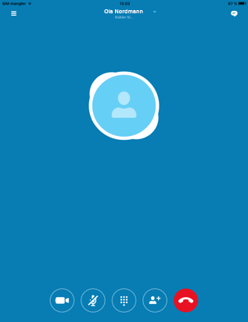
Starting or accepting a call
7
Notes:
Once you have found the contact you want to talk to, tap either the video camera icon or the phone icon on the screen to start a call.

Slide 14
Starting or accepting a call
7
Notes:
If you tap the phone icon, you will start a call without a live video, just like a normal phone call.

Slide 15
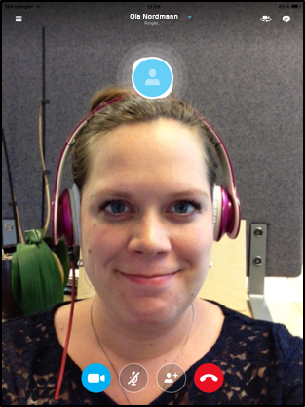
Starting or accepting a call
7
Notes:
If you tap the video camera icon, you start a call with a live video of yourself.

Slide 16
Starting or accepting a call
7
Notes:
When someone calls you, you will hear a ringtone and your screen will look like this.

Slide 17
Starting or accepting a call
7
Notes:
You have three options when someone calls you.
You can tap the red button to reject the call.

Slide 18
Starting or accepting a call
7
Notes:
If you tap the green phone icon, you accept the call, but the person calling you can only hear your voice – they cannot see a live video of you while you are talking.

Slide 19
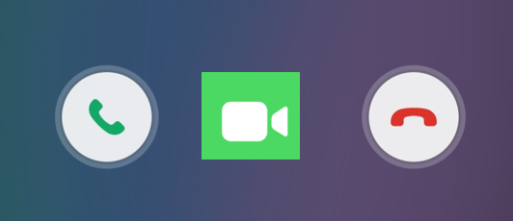
Starting or accepting a call
7
Notes:
If you tap the green video camera icon, you start a video call where you can see each other and talk together, provided that you both have the necessary equipment.

Slide 20
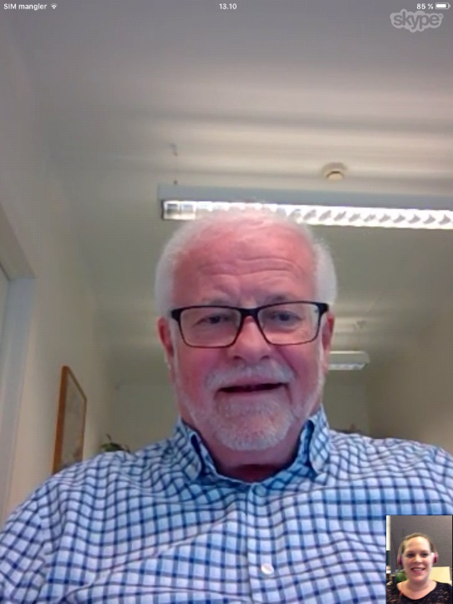
Starting or accepting a call
7
Kari
Ola
Notes:
Your screen will then look something like this.
You will see a large picture of the person you are talking to on the screen and a smaller picture of yourself in the bottom right-hand corner.

Slide 21
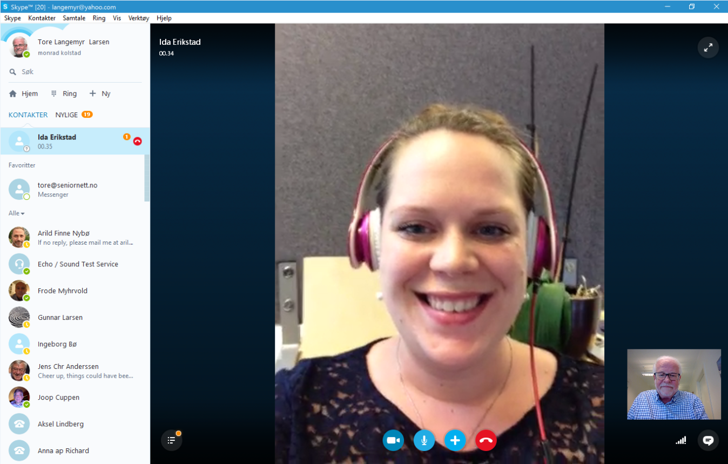
Starting or accepting a call
7
Kari
Ola
Notes:
The same picture of you appears on the screen of the person you are talking to.

Slide 22
Starting or accepting a call
7
Kari
Ola
Notes:
Similarly, the person you are talking to will see a large picture of you on their screen, and a smaller version of the same picture you can see of them in the bottom right-hand corner of their screen.

Slide 23
Starting or accepting a call
7
Notes:
These four symbols will always appear on the screen of PCs.

Slide 24
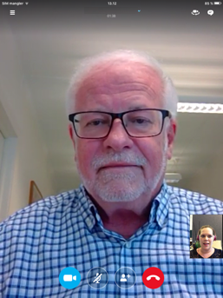
Starting or accepting a call
7
Notes:
The same symbols will appear if you tap the screen on a tablet or smartphone once.

Slide 25
Starting or accepting a call
7
Notes:
If you tap the video camera once, the person you are talking to will no longer be able to see you.

Slide 26
Starting or accepting a call
7
Notes:
If you tap the button again, the live video will reappear.

Slide 27
Starting or accepting a call
7
Notes:
If you tap the microphone icon once, the person you are talking to will no longer be able to hear you.

Slide 28
Starting or accepting a call
7
Notes:
If you tap the button again, the sound will return.

Slide 29
Part 5
Ending a call

Slide 30
Starting or accepting a call
7
Ending a call
Notes:
To end the call, tap the red button.

Slide 31
That’s it – Well done everyone!
That’s it – Well done everyone!
Now you can practise:
Calling with and without a live video
Accepting and rejecting calls
Turning sound and vision on and off during a call

