Slide 1
LEARNING TO USE THE INTERNET
Learning objectives:
Being able to open the browser
Knowing a little about URLs
Being able to orientate themselves on a website
To be able to search with one and more words
Being able to open a new tab
Being able to switch between tabs
Notes:
Go through the learning objectives with the course participants before you begin teaching.
This will make it easier for them to focus on and remember the most important information.

Slide 2
Part 1
Opening a web browser and learning about web addresses

Slide 3



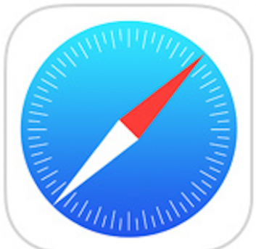
Opening a web browser and learning about web addresses
1
Chrome
Explorer
Firefox
Safari
Notes:
A web browser is a program used to show websites on the internet. There are a number of different web browsers available. These are the four most common ones.

Slide 4
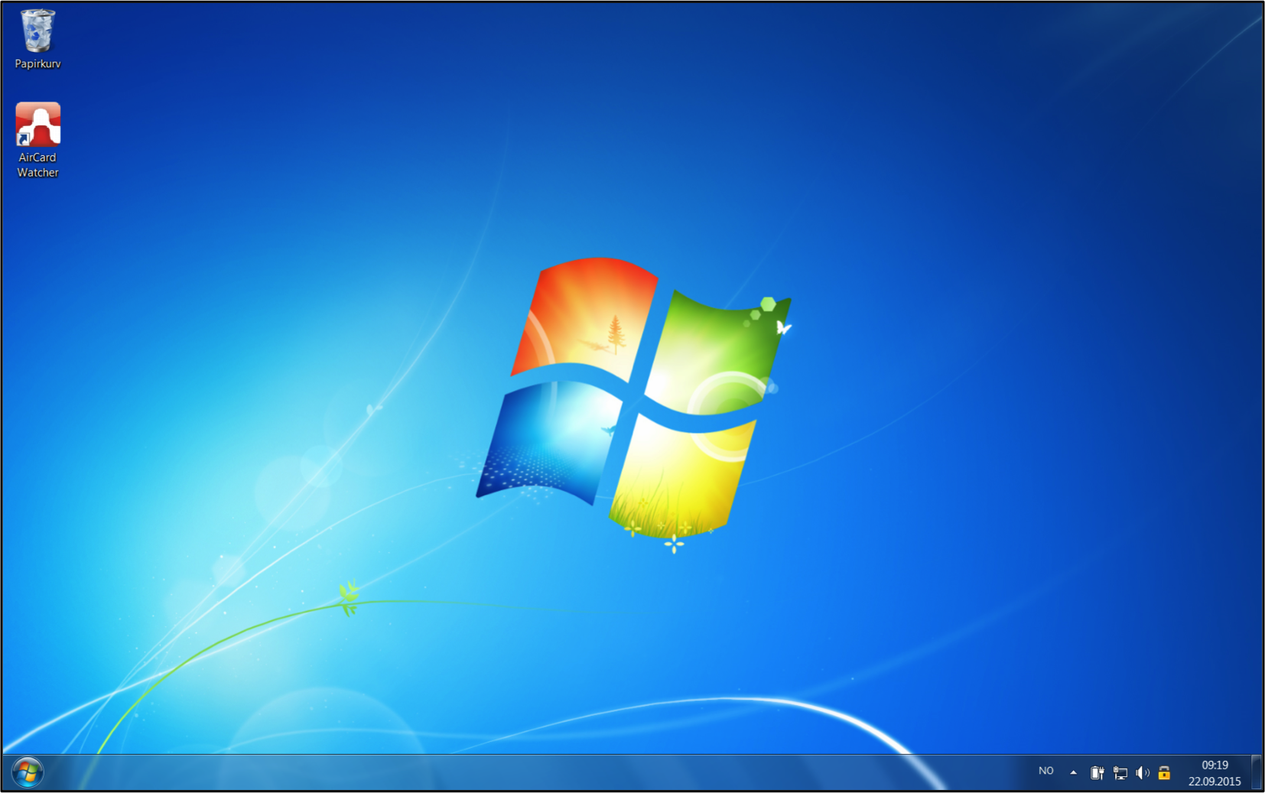
Opening a web browser and learning about web addresses
1
PC
Nettleser
Oppgavelinje
Notes:
Those using PCs will often find their web browser located on the task bar.

Slide 5
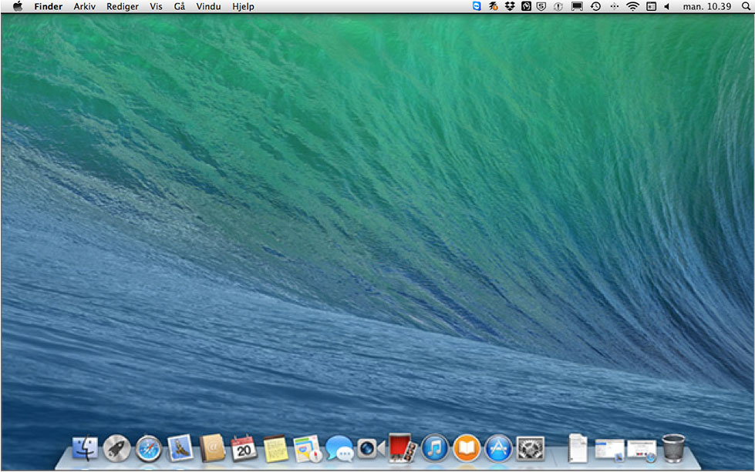
Opening a web browser and learning about web addresses
1
MAC
Nettleser
Dock
Notes:
Mac users will find the web browser in the Dock.

Slide 6



Opening a web browser and learning about web addresses
1
Nettbrett
Nettleser
Nettleser
Nettleser
Nettleser
Notes:
Tablet users need to find the icon for their web browsers among the other icons on their desktop.

Slide 7
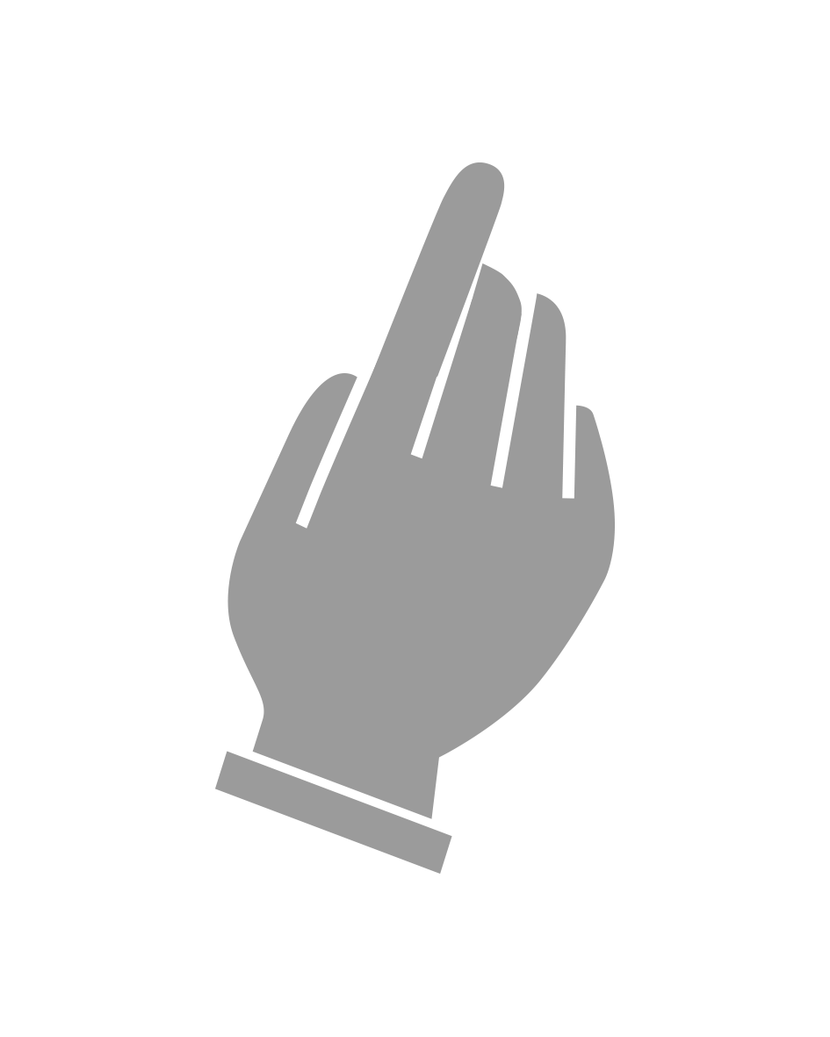
Opening a web browser and learning about web addresses
1
Notes:
Find the icon for your web browser and click on it.
Help everyone to find their icon and open a web browser.

Slide 8
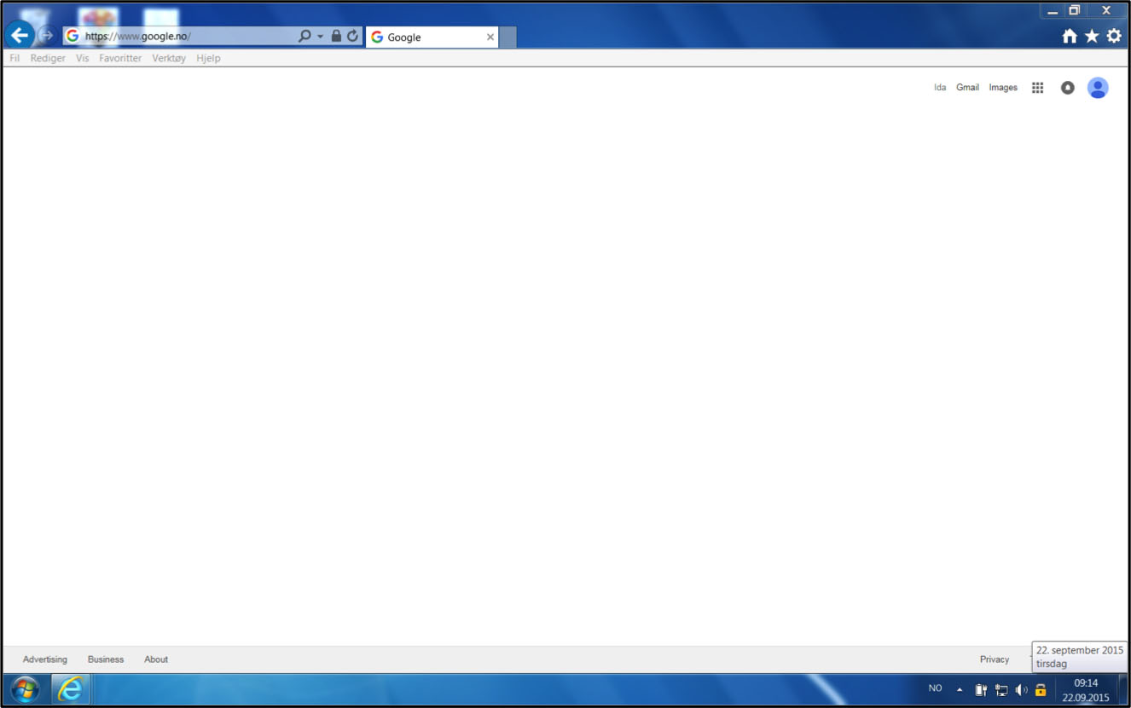
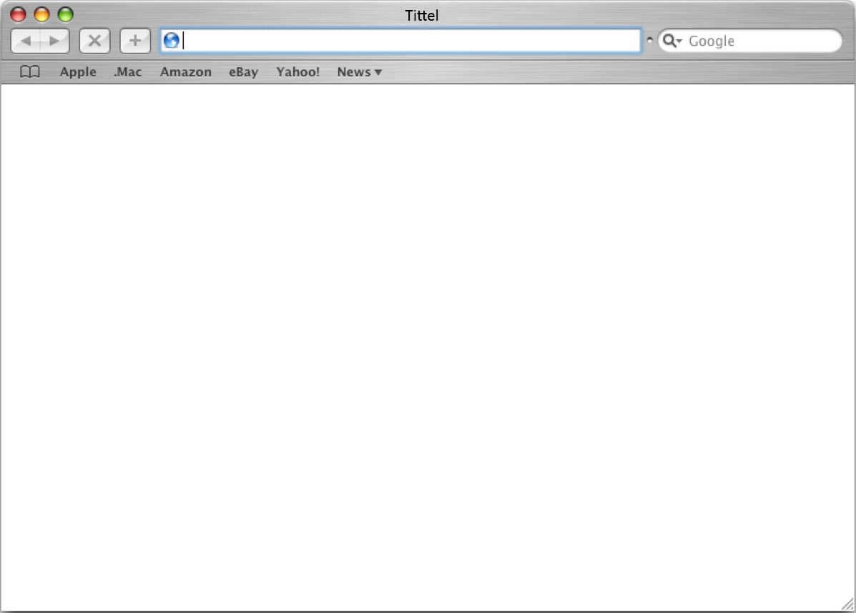
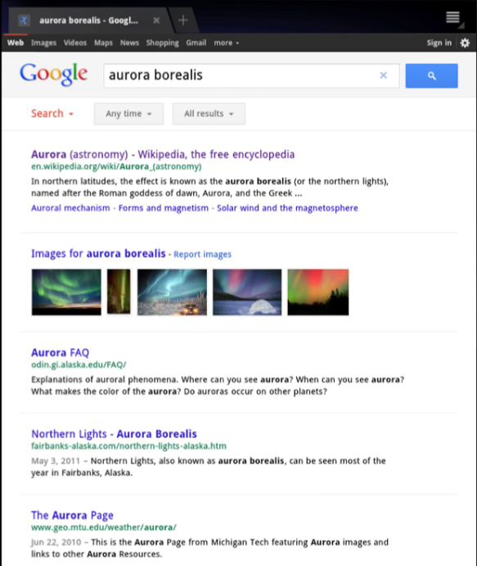
Opening a web browser and learning about web addresses
1
Adresselinje
PC
Søkefelt
PC
Adresselinje
Mac
Søkefelt
Mac
Adresselinje
nettbrett
Søkefelt
nettbrett
Notes:
Even though they look a little different, all web browsers consist of the same main components.
The most important component is the address bar. Here, you can enter web addresses or search words.
Here you can see the address bar on a typical PC, Mac and tablet.

Slide 9
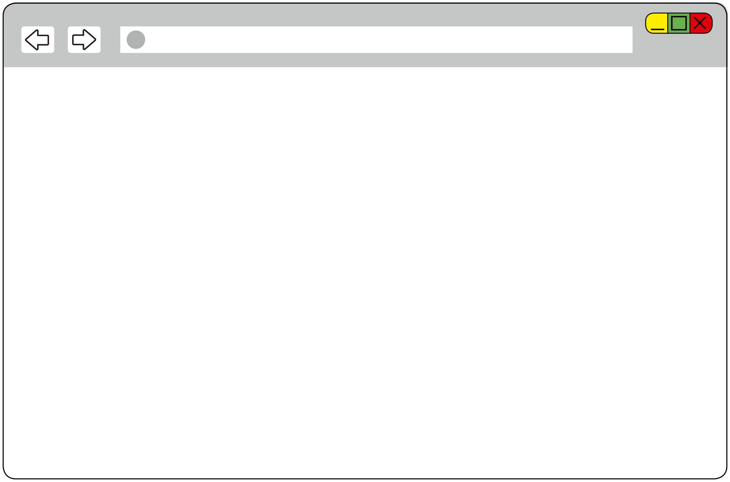
Opening a web browser and learning about web addresses
1
Notes:
I will use this simplified window to make it easier for you to see what I’m doing.

Slide 10
Opening a web browser and learning about web addresses
1
www.kongehuset.no
Notes:
All websites have a web address. When you enter a web address in the address bar, you let the web browser know which page you’d like to visit. We will use the Royal Family’s website as an example: ‘www’ means that the page is on the world wide web.

Slide 11
Opening a web browser and learning about web addresses
1
www.kongehuset.no
Notes:
‘kongehuset’ (the Royal House) is the name of the site.

Slide 12
Opening a web browser and learning about web addresses
1
www.kongehuset.no
Notes:
‘.no’ means that the site is Norwegian.
Using web addresses is very convenient when you know the address of the page you want to visit. Then you know that you’ll get to the right place. Later, we will learn how to search for a site.

Slide 13


Opening a web browser and learning about web addresses
1
www.kongehuset.no
Enter
Go
Return
Notes:
To type in an address bar, first you have to click on it. When you have finished typing the address, press the ‘Enter’ button on the keyboard. The button is fairly large and located to the right of the letter keys. Some keyboards will have ‘Enter’ written on this key, while on others it will be labelled ‘Go’ or ‘Return’. Some will show a symbol of an angled arrow.
Ask everyone to type ‘www.kongehuset.no’ in their web browser and hit ‘Enter’.
It might take a little while for the site to appear.

Slide 14
Part 2
Navigating a website

Slide 15
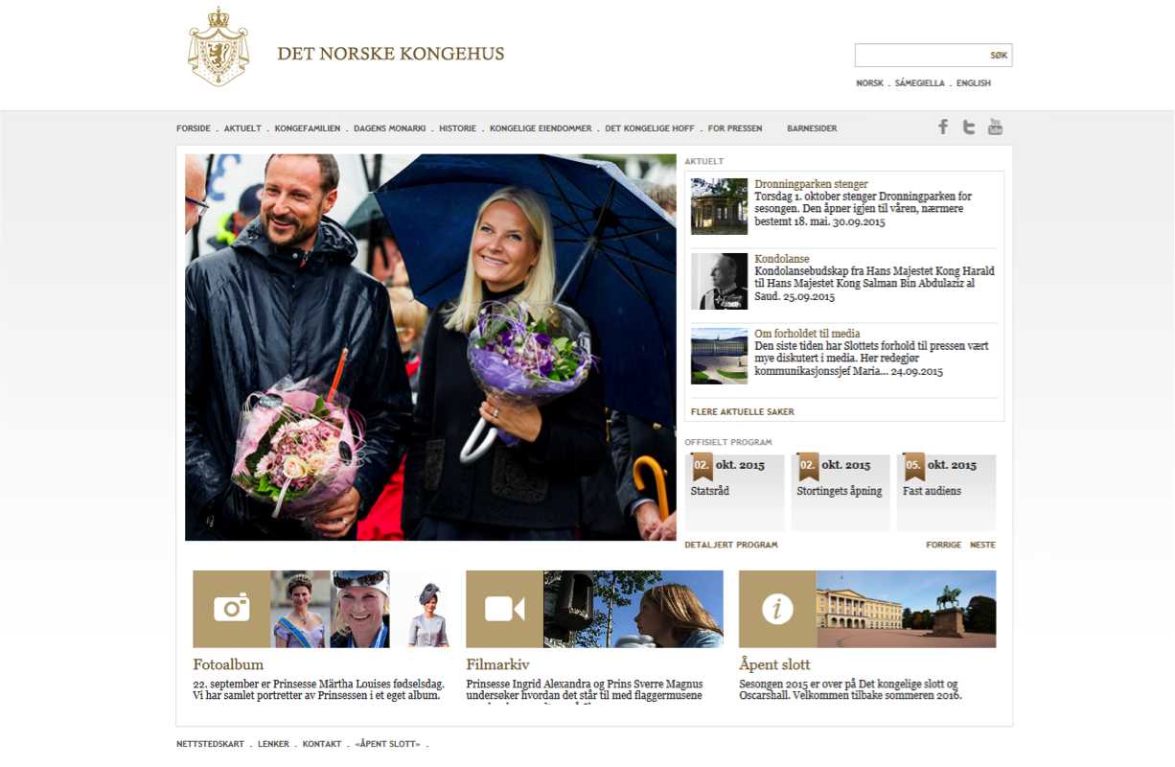

Navigating a website
2
Notes:
The first page to appear is the home page. It contains some information, but not everything. To find information about other topics, you can use the menu on the website. It is usually found either at the top or on the left-hand side of the page. Click on a menu heading to open it. You can also click on other items, such as photos and articles, to read more. Anything that you can click on is called a link.

Slide 16

Navigating a website
2
Notes:
Computer users will see that the cursor changes into a little hand whenever it is over a link you can click on.
Have everyone try to click on a few items on the page.

Slide 17
Navigating a website
2
Gå tilbake
Notes:
Sometimes, you might click on a link without meaning to, or you might for some other reason want to go back to something you were looking at earlier. There are two arrow buttons directly to the left of the address bar. Click on the left arrow to go back.

Slide 18
Navigating a website
2
Gå frem
Notes:
To go forward, click on the right arrow.
Ask everyone to click on some links and to try to go back and forward.

Slide 19
Part 3
Searching using one or more search words

Slide 20
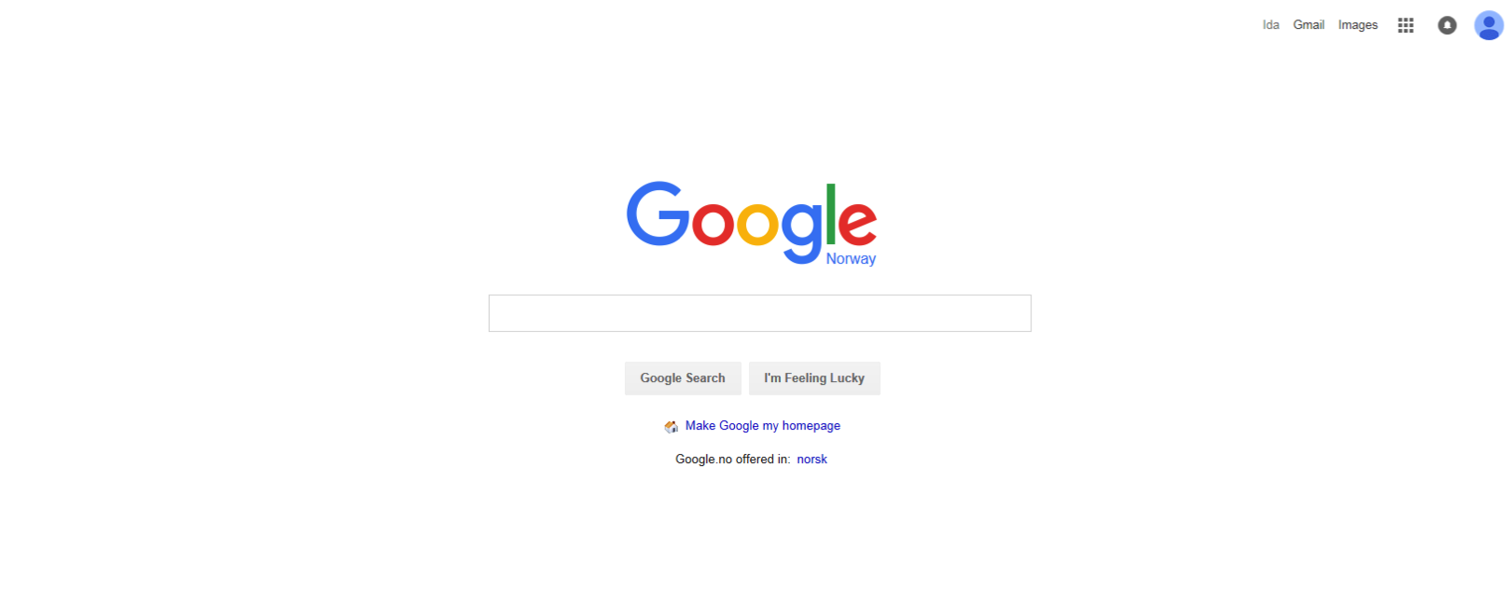
Searching using one or more search words
3
Adresselinje
og søkefelt
www.google.no
Søkefelt
Notes:
You might not always know exactly what website you want to visit. In such case, you can perform a search. There are many search engines out there, though Google is the most common one. Some people actually call searching online ‘googling’.
Ask everyone to go to google.no.
On google.no, you will see a search field in the middle of the screen. As we heard earlier, the address bar can also be used as a search field, but now we will be using Google.

Slide 21
Searching using one or more search words
3
www.google.no
Enter
Go
Return
Kart
Notes:
To search for a topic, type it into the search field and hit ‘Enter’.

Slide 22
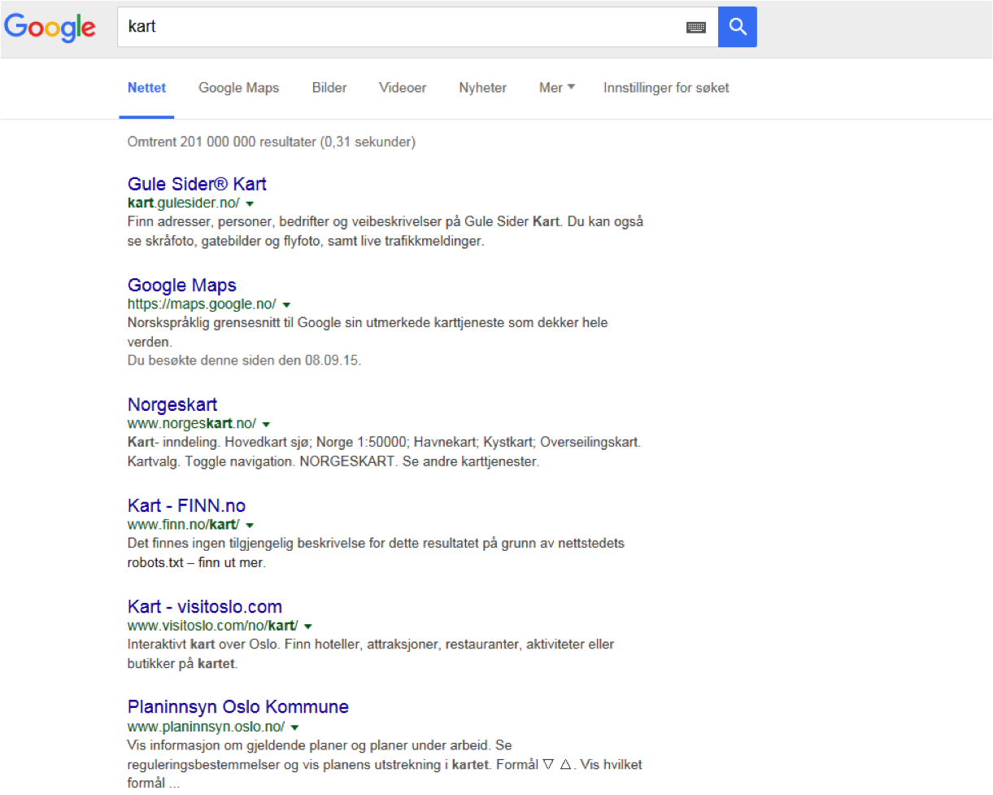
Searching using one or more search words
3
www.google.no
Notes:
It is important to be as exact as possible when you search. If you search for the word ‘map’, for example, you will be told that there are over two hundred million matches. This isn’t really useful if I want to learn about the poet Walter Map. If you type in ‘Walter Map’, however, you will have fewer matches, but most of them will relate to the poet.

Slide 23
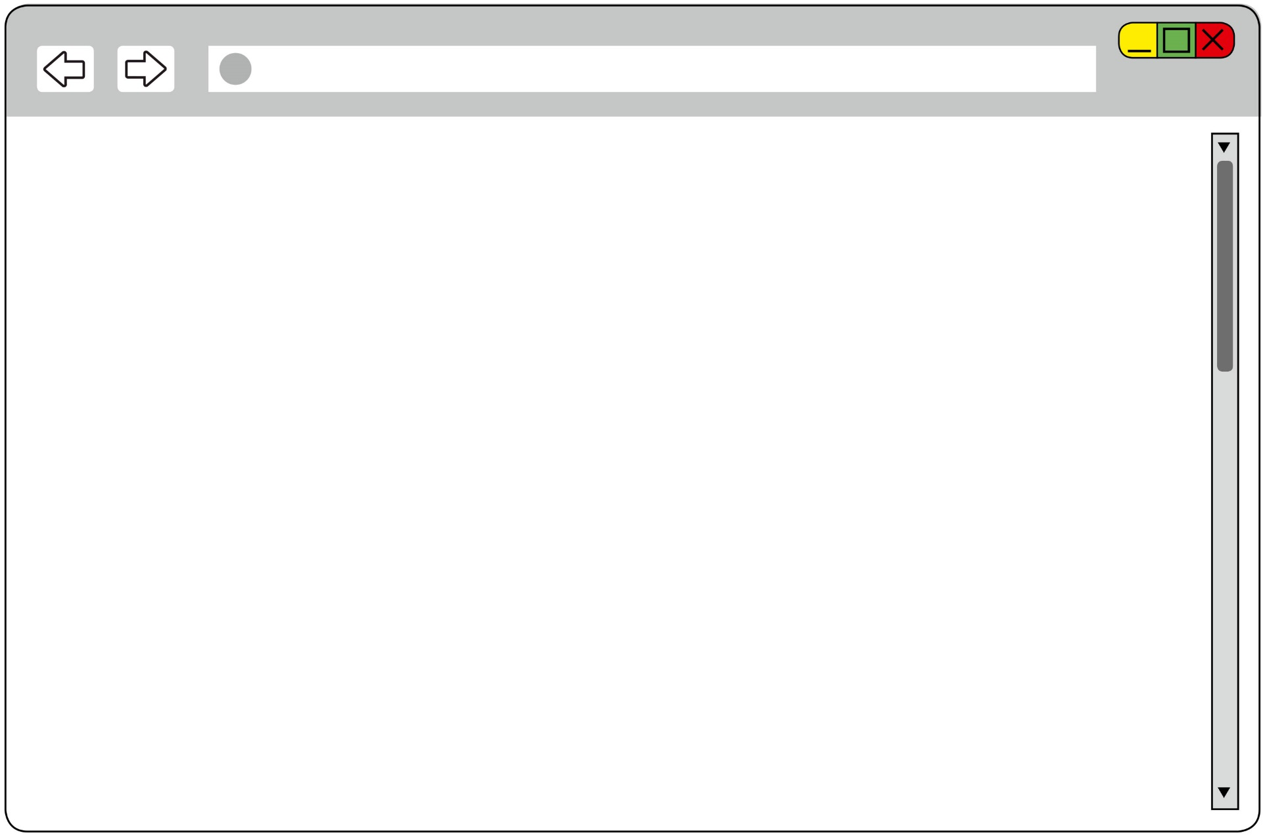
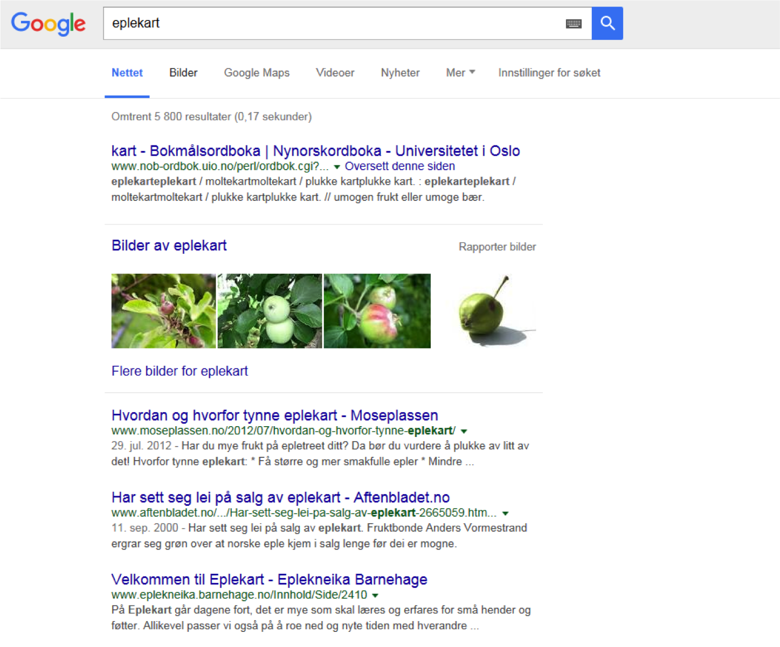
Searching using one or more search words
3
www.google.no
Notes:
Many pages contain more information than what will fit on the screen. You then have to scroll down to see everything. Those using computers will have a scrollbar on the right-hand side of the screen.
Click and drag to move up and down the page.

Slide 24
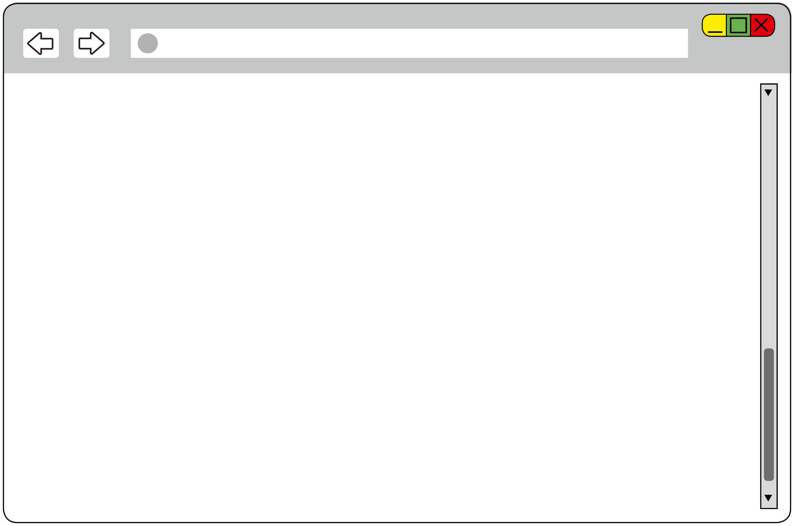
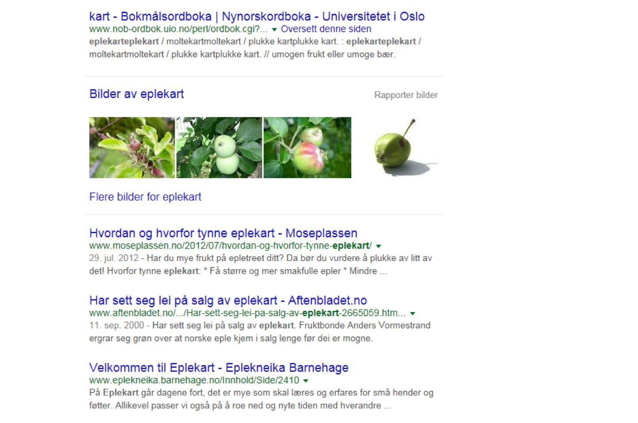
Searching using one or more search words
3
www.google.no
Notes:
Many pages contain more information than what will fit on the screen. You then have to scroll down to see everything. Those using computers will have a scrollbar on the right-hand side of the screen.
Click and drag to move up and down the page.

Slide 25
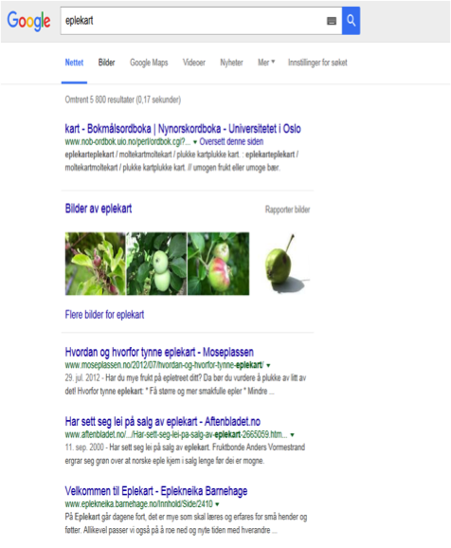
Searching using one or more search words
3
Notes:
If you have a tablet, swipe the screen with your finger to move up and down on the page.

Slide 26
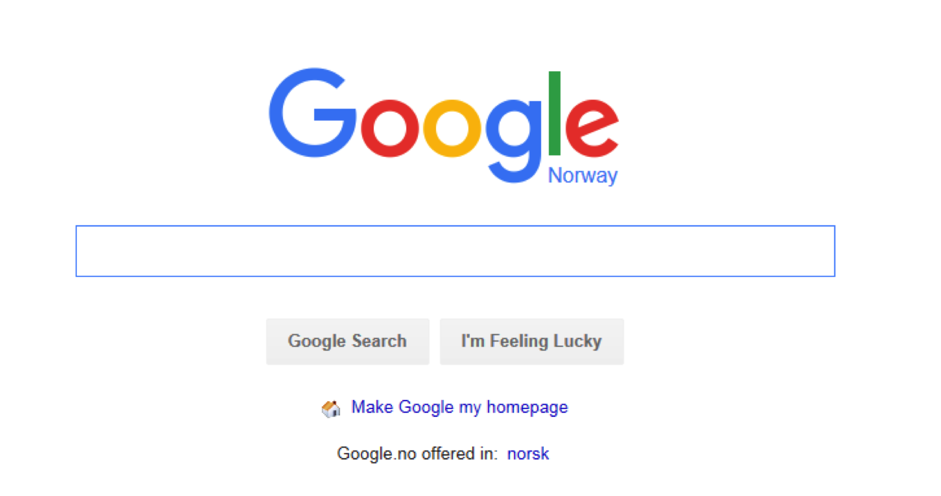
Searching using one or more search words
3
www.google.no
Hotell Moss
Notes:
You will often wish to search for more than one word. If, for example, you are travelling to Moss, Norway and want to stay at a hotel, you can search for ‘Hotel Moss’. The search engine will then show us all pages containing the words ‘hotel’ and ‘Moss’, regardless of whether the words are next to or relate to each other. This means that you might see articles about tourism in Østfold county, the municipality’s website, news articles and a lot of other things.
Of course you will also see pages actually listing hotels in Moss.

Slide 27
Searching using one or more search words
3
www.google.no
"Hotell i Moss"
Notes:
To make sure we get as many such matches as possible, we can use quotation marks and search for ‘“Hotels in Moss”’, which will yield only search results where the words occur in that order. This is also a good way of searching for song lyrics or quotes.

Slide 28
Searching using one or more search words
3
www.google.no
"Hotell i Moss” svømmebasseng
Notes:
You can also search using a combination of words in quotation marks and words without.

Slide 29
Part 4
Tabs

Slide 30
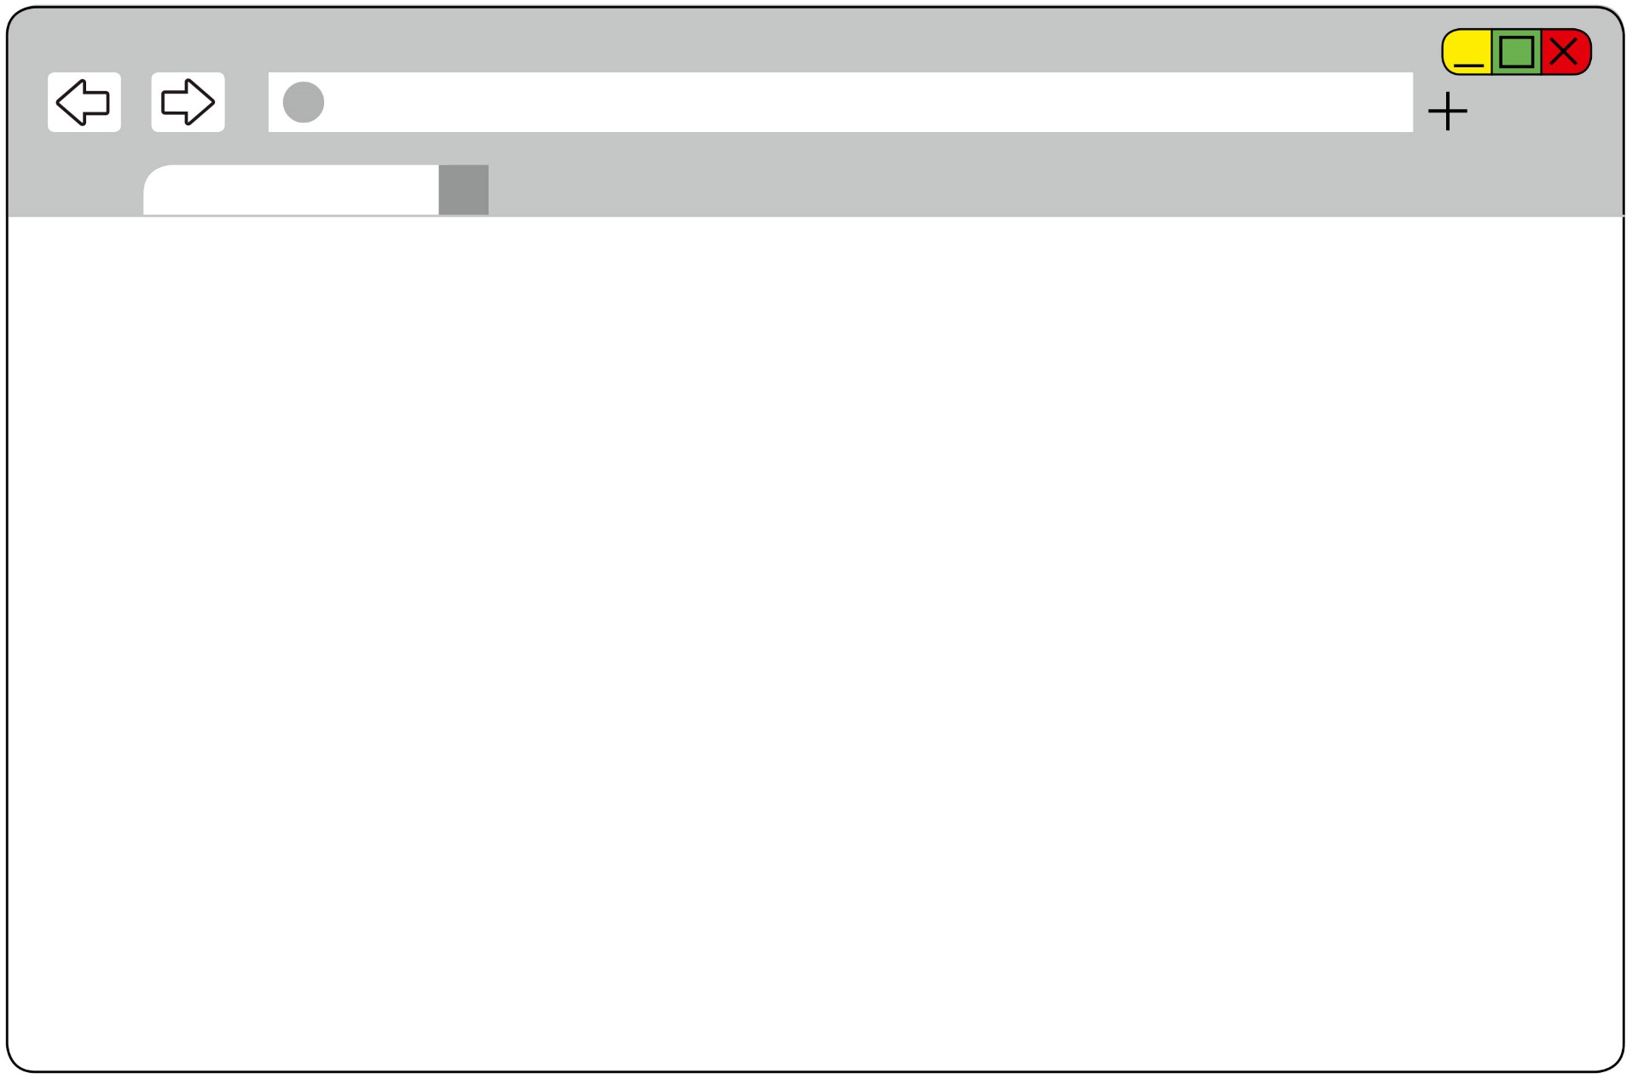
Tabs
4
Kongehuset
Notes:
Sometimes you might want to open a new website but still have the option of quickly going back to the page you are on. To do this, you can open a ‘tab’.

Slide 31
Tabs
4
Kongehuset
Notes:
One way of opening a tab is to click the empty area next to the tab you already have open (where you see the name of the site you are on).

Slide 32
Tabs
4
Kongehuset
Notes:
Those of you who don’t have such an empty area can locate the plus sign to the right of the address line and click on it.
Help everyone to open a new tab.

Slide 33
Tabs
4
Kongehuset
Google
Notes:
In this new tab, you can search for or open a new page.

Slide 34
Tabs
4
Kongehuset
Google
Notes:
If you want to see the other tab again, just click on it.

Slide 35
Tabs
4
Kongehuset
Google
Notes:
If you want to go back to the new page, just click on that tab again. You can open as many tabs as you like.

Slide 36
Ferdig – godt jobba alle sammen!
Nå kan dere øve på å:
Åpne nettleseren
Gå inn på hjemmesider
Søke med ett og flere ord
Åpne en ny fane
Bytte mellom faner
Notes:
THAT'S IT!

